Slide 1

CPU Scheduling
Algorithms for CPU Scheduling
Evaluation of Various Scheduling Algorithms
Notes:
Page 285

Slide 2
SJF Scheduling
This is an optimal scheduling algorithm
Gives the minimum average waiting time for a set of processes
Problem is to estimate the length of the next CPU request
It can be used for long-term scheduling using users’ mentioned estimated time
Prediction algorithms that predict next CPU burst using past statistics can be useful for CPU scheduling
This can be predicted as an exponential average of the measured lengths of the previous CPU bursts
Let t_{n} be the nth CPU burst and Ƭ_{n+1} be the predicted value

Slide 3
SJF Scheduling
Then for α, 0 ≤ α ≤ 1
Ƭ_{n+1} = α t_{n} + (1 – α) Ƭ_{n}
t_{n} contains the most recent info. and Ƭ_{n} has past history
The parameter α controls the relative weight of recent and past history in our prediction
Most commonly used value of α is ½
SJF algorithm can be either preemptive or non-preemptive
A newly arrived process may have a shorter duration next CPU burst than what is left of the currently executing process
Preempt the currently executing process
Shortest-remaining-time-first-scheduling
Notes:
If α = 0 or 1…. Շ0 is taken as 10 and α = 0.5

Slide 4
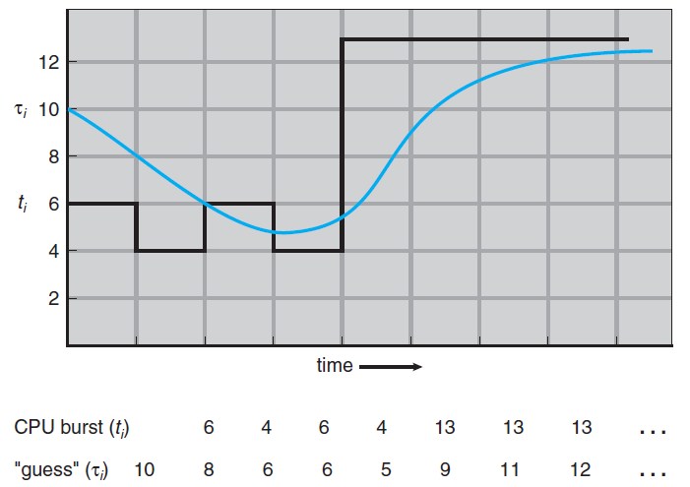
Prediction of the Length of the Next CPU Burst
Notes:
4

Slide 5
Preemptive SJF Scheduling
Process Arrival Burst
Time Time
P1 0 8
P2 1 4
P3 2 9
P4 3 5

Slide 6
Priority Scheduling
SJF is a special case of priority scheduling algorithm
Priority (p) is the inverse of the predicted next CPU burst
Priorities are generally indicated by a fixed range of numbers
0 is the highest priority and n is the lowest priority
Priorities can be defined internally or externally
Internal priority is determined using some measurable quantity to compute the priority
External priorities are determined by criteria outside the control of the OS
Priority scheduling can be either preemptive or non-preemptive
Notes:
Internal – time limits, memory requirements, I/O and CPU bursts, etc.,

Slide 7
Example of Priority Scheduling
Process Burst Time Priority
P1 10 3
P2 1 1
P3 2 4
P4 1 5
P5 5 2
P2
P5
P1
P3
P4
Find the average waiting time

Slide 8
Priority Scheduling
Preemptive priority scheduling algorithm allows a newly arrived higher priority process to preempt a currently running lower priority process
A non-preemptive priority scheduling algorithm will put the new process at the head of the ready queue
Problem with priority scheduling algorithm
Indefinite blocking or starvation
A low priority process may have to wait indefinitely
Aging can be used to solve this problem
Technique of gradually increasing the priority of processes that wait in the system for a long time

Slide 9
Round-Robin Scheduling
This algorithm is designed for time-sharing systems
Time quantum or time slice is defined
Generally between 10 to 100msec interval
Ready queue is treated as a circular queue
Each process in the ready queue is allocated a time quantum
Ready queue is a FIFO queue
A timer is set to interrupt at the end of every time quantum
Average waiting time of RR is long
This scheduling algorithm is preemptive

Slide 10
Example of RR with Time Quantum = 4
Process Burst Time
P₁ 24
P₂ 3
P₃ 3
P₁
P₂
P₃
P₁
P₁
P₁
P₁
P₁
0
4
7
10
14
18
22
26
30
Notes:
10

Slide 11
Round-Robin Scheduling
Every process is allocated only a single time quantum in a row
If there are n processes in the ready queue and the time quantum is q
Each process gets 1/n of CPU time in chunks of at most q time units
Each process must wait for (n – 1) x q time units until the next time quantum
Performance of RR algorithm depends on the size of the time quantum
For very large time quantum
RR policy is very close to FCFS policy
For very small time quantum
RR is referred to as processor sharing

Slide 12
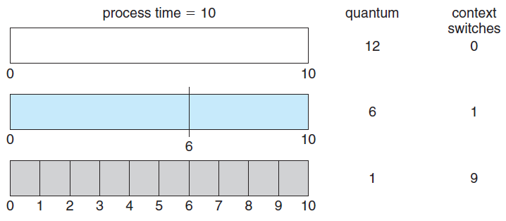
Time Quantum and Context Switch Time
Notes:
12

Slide 13
Round-Robin Scheduling
Each of the n processes has its own processor running at 1/n of the speed of the real processor
Consider the effect of context switching on the performance of RR scheduling
Time quantum should be large with respect to context switching time
Turnaround time depends on the time quantum
Average turnaround time improves if most of the processes finish their next CPU burst in a single time quantum
A rule of thumb
80 percent of the CPU bursts should be shorter than the time quantum

Slide 14
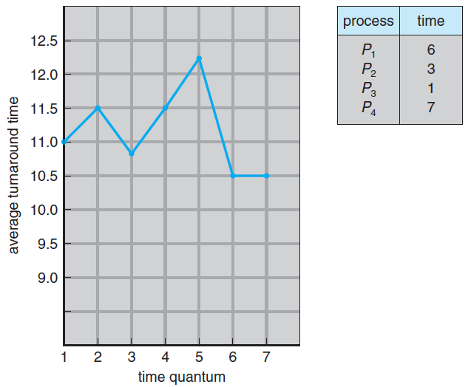
Turnaround Time Varies With The Time Quantum
Notes:
14

Slide 15
Multilevel Queue Scheduling
Scheduling algorithms created for systems where processes can be classified into different groups
Each group may have a different response time requirements and scheduling needs
Foreground (interactive) and background (batch) processes
Ready queue is partitioned into several separate queues
Each queue has its own scheduling algorithm
Scheduling is also required among the queues
Fixed-priority preemptive scheduling
Processes are permanently assigned to a particular queue

Slide 16
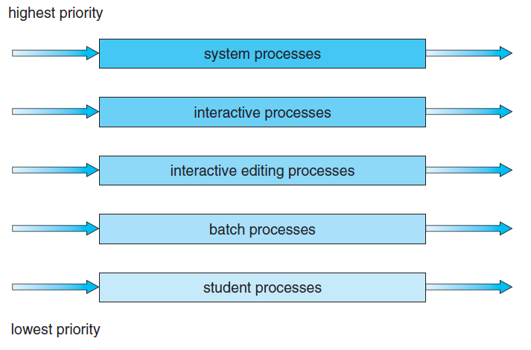
Multilevel Queue Scheduling
Notes:
16

Slide 17
Multilevel Feedback-Queue Scheduling
This algorithm allows a process to move between queues
Processes are separated on the basis of CPU bursts
Processes that have longer CPU bursts are moved to a lower priority queue
Aging can be used to prevent starvation
This scheduler is defined by the following parameters
The number of queues
The scheduling algorithm for each queue
Method used to determine when to upgrade a process

Slide 18
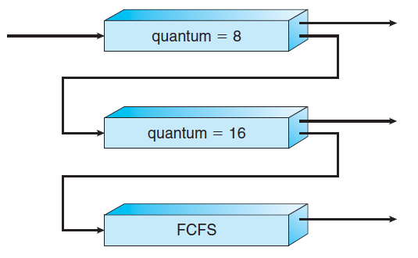
Multilevel Feedback Queues
Notes:
18

Slide 19
Multilevel Feedback-Queue Scheduling
Method used to determine when to demote a process
Method used to determine the queue for a process
The most general scheduling algorithm
This is also the most complex algorithm

Slide 20
Thread Scheduling
In systems that support user and kernel-level threads, kernel-level threads are scheduled by the OS
Kernel-level threads instead of processes are scheduled
User-level threads are managed by a thread library
To run on the CPU, the user-level thread must be mapped on an associated kernel- level thread
Other sub-topics shall be discussed later

Slide 21
Multiple Processor Scheduling
Load sharing is possible through multiprocessors
Scheduling problem becomes more complex
Homogeneous MPs where processors are identical and heterogeneous MPs
MP Scheduling Approaches
Asymmetric Multiprocessing
All scheduling decisions are handled by a single processor
The master server
Scheduling is simple: Access to system data structure is done by a single processor
Symmetric Multiprocessing
Each processor is self-scheduling

Slide 22
Multiple Processor Scheduling
Common ready queue or private queues
Scheduler must be programmed carefully
Load Balancing
Keep the workload evenly distributed across all processors in an SMP system
Necessary in those systems where each processor has its own private ready queue
Not necessary where there is a common ready queue
Two general approaches to load balancing
Push migration
A specific task periodically checks the load on each processor

Slide 23
Multiple Processor Scheduling
Evenly distributes the load by moving or pushing processes in case of imbalance
Schedules on idle or less busy processors
Pull Migration
An idle processor pulls a waiting task from a busy processor
The two approaches need not be mutually exclusive
Multicore Processors
The structure of current generation processors are like SMPs
Complicates multicore processor scheduling

